Slide 1
Carry Look Ahead Adder

Slide 2
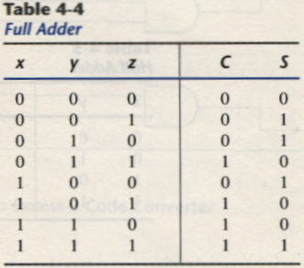
Carry Look Ahead Adder
Binary adder causes a unstable factor on carry bit, and produces a longest propagation delay.
The signal from C_{i} to the output carry C_{i+1}, propagates through an AND and OR gates, so, for an n-bit RCA, there are 2n gate levels for the carry to propagate from input to output.
Because the propagation delay will affect the output signals on different time, so the signals are given enough time to get the precise and stable outputs.
The most widely used technique employs the principle of carry look-ahead to improve the speed of the algorithm.
No Carry
Carry Propagate
Carry Generate

Slide 3
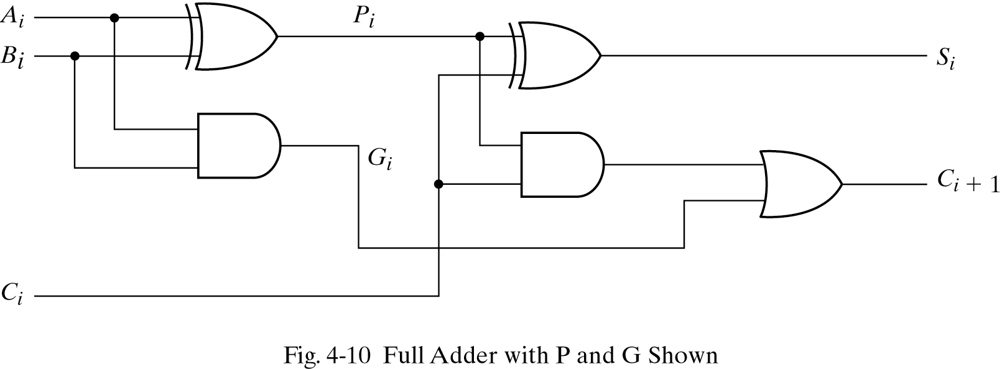
P_{i} = A_{i} ⊕ B_{i} steady state value
G_{i} = A_{i}B_{i} steady state value
Output sum and carry
S_{i} = P_{i} ⊕ C_{i}
C_{i+1} = G_{i} + P_{i}C_{i}
G_{i} : carry generate P_{i} : carry propagate
C₀ = input carry
C₁ = G₀ + P₀C₀
C₂ = G₁ + P₁C₁ = G₁ + P₁G₀ + P₁P₀C₀
C₃ = G₂ + P₂C₂ = G₂ + P₂G₁ + P₂P₁G₀ + P₂P₁P₀C₀
C₃ does not have to wait for C₂ and C₁ to propagate.

Slide 4
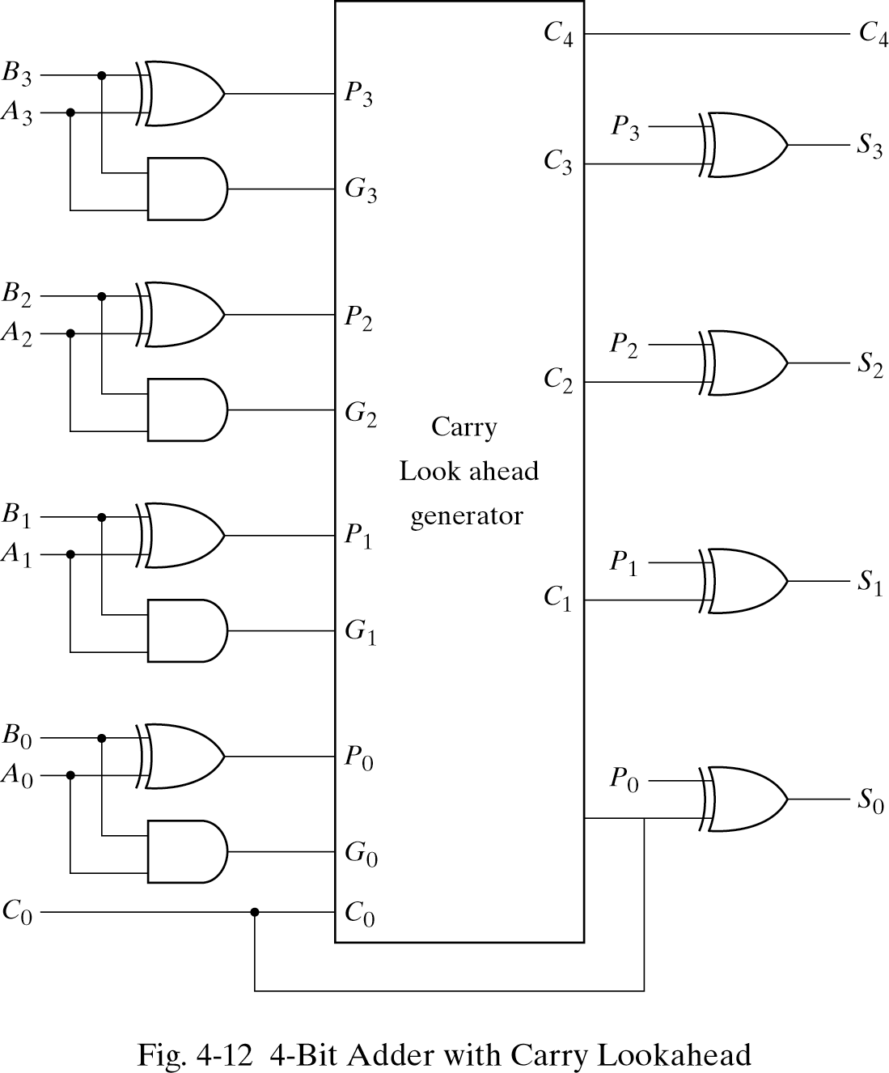
4-bit Carry Look Ahead Adder

Slide 5
Thank You

